Slide 1

Hello ☺
Sue Bayes, Independent Power BI developer
Own business
Time is important
www.databayes.co.uk
https://www.linkedin.com/in/suebayes/
https://www.meetup.com/devon-and-cornwall-power-bi-meetup-group/
Notes:
DataRelayLapTop pbix
Performance analyser
Power BI service

Slide 2


Slide 3
Query Folding
How are Queries Executed?
What is Query Folding?
Why is it important?
How do you know it’s happening?
What stops Query Folding?
Considerations
Report
Notes:
Basics: Spend the first 5 minutes explaining SQL and data querying.
Key terms: SQL, Database, Query.
Intro to Query Folding: 10 minutes
Definition: It's a technique that optimizes queries.
Benefits: Speeds up data retrieval.
Examples: 15 minutes
Demo 1: Query with query folding.
Demo 2: Query without query folding.
Show how to measure performance.
Do's and Don'ts: 10 minutes
Do's: Filters, column selection.
Don'ts: Custom columns, certain functions.
Tools and Monitoring: 5 minutes
Mention tools to monitor queries.
Q&A: 5-10 minutes
Take questions, clarify doubts.

Slide 4
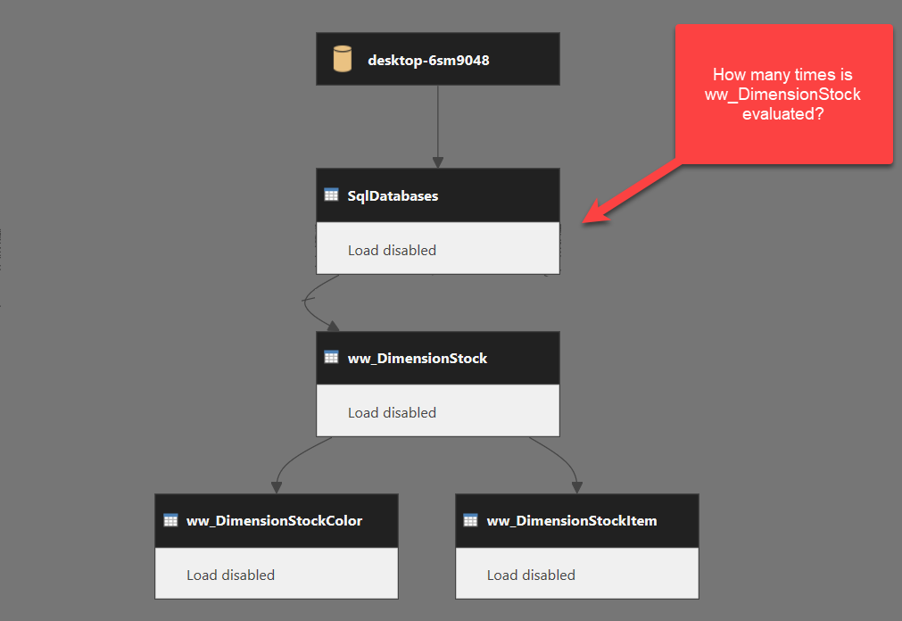
How Queries are executed
SQLBITS2022 - Chris Webb Performance Tuning and Dataflows in Power BI
Notes:
Bottom up
Lazy Evaluation
Do in the most efficient order – streaming semantics

Slide 5

What is Query Folding?
If query folding is possible, it can improve the performance of the query.
It's worth noting that not all query steps can be folded – data source type and language
Little documentation
Step by step
Power Query transforms data into tidy data ready for modelling
Transformations happen in Power BI or can be pushed to data source
Query Folding happens in Power Query when transformations pushed back to data source
Report
Notes:
Sources that support Query Foldng
Sql server, Odata feeds including Sharepoint lists, Exchange and Active Directory
Query folding is a process in Power Query where the query engine tries to convert the user's query steps into a single optimized SQL statement that can be sent to the data source.
If query folding is possible, it can reduce the amount of data that needs to be transferred over the network and improve the performance of the query.
It's worth noting that not all query steps can be folded, and some data sources may not support query folding at all. However, by understanding query folding and designing queries with query folding in mind, you can improve the performance and accuracy of your Power Query queries.
This session will demonstrate the key principles to enable query folding to happen and those that can reduce folding.
Only pulling what you need into Power BI
Load goes to data source = / -
Required for Incremental Refresh
Order of steps important

Slide 6

Why is Query Folding important?
Speed
Import
Direct Query
Incremental Refresh
Stability
think about the query…
Notes:
Import model tables:
Where data is stored likely to have more resources and be better maintained
Less data to be transferred over the network
DirectQuery and Dual storage mode tables: Each DirectQuery and Dual storage mode table (Power BI only) must be based on a Power Query query that can be folded.
Incremental refresh: Incremental data refresh (Power BI only) will be efficient, in terms of resource utilization and refresh duration. In fact, the Power BI Incremental Refresh configuration window will notify you of a warning should it determine that query folding for the table can't be achieved. If it can't be achieved, the goal of incremental refresh is defeated. The mashup engine would then be required to retrieve all source rows, and then apply filters to determine incremental changes.
Query folding may occur for an entire Power Query query, or for a subset of its steps. When query folding cannot be achieved—either partially or fully—the Power Query mashup engine must compensate by processing data transformations itself. This process can involve retrieving source query results, which for large datasets is very resource intensive and slow.
We recommend that you strive to achieve efficiency in your model designs by ensuring query folding occurs whenever possible.

Slide 7
Is Query Folding happening?
Look at the queries being run on your data source:
View Native Query is enabled (folding may happen even if disabled)
Power Query diagnostic logs
Power Query online indicators
What happens when you load data?
What happens when you refresh?
Running a profile trace on SQL Server
(analysis services engine)
Notes:
Example 01 Select and Filter – show Native Query in PBI Desktop
Show in Sql profiler –
set up sql profiler with a template for power query with specific columns and events picked. Saved template as default.
able to see length of time taken
can use Phil Seamark Power BI report to visualise
Show in metadata
Show in diagnostic – but complicated
Show in power query online – visual and query plan

Slide 8
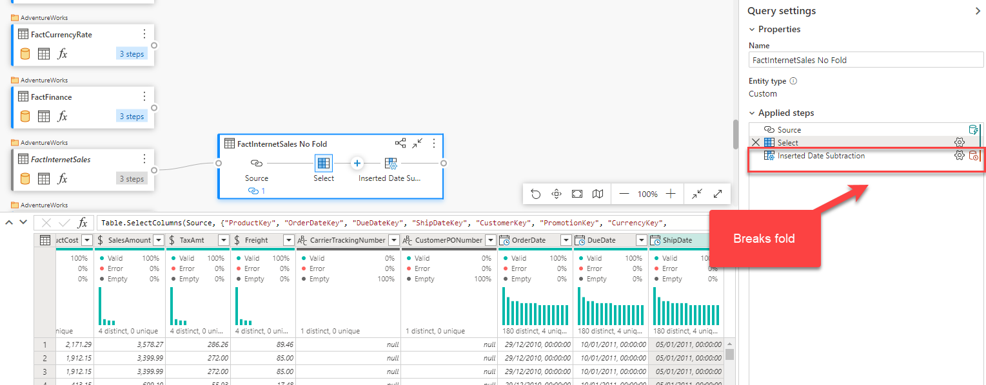
Power Query Online

Slide 9
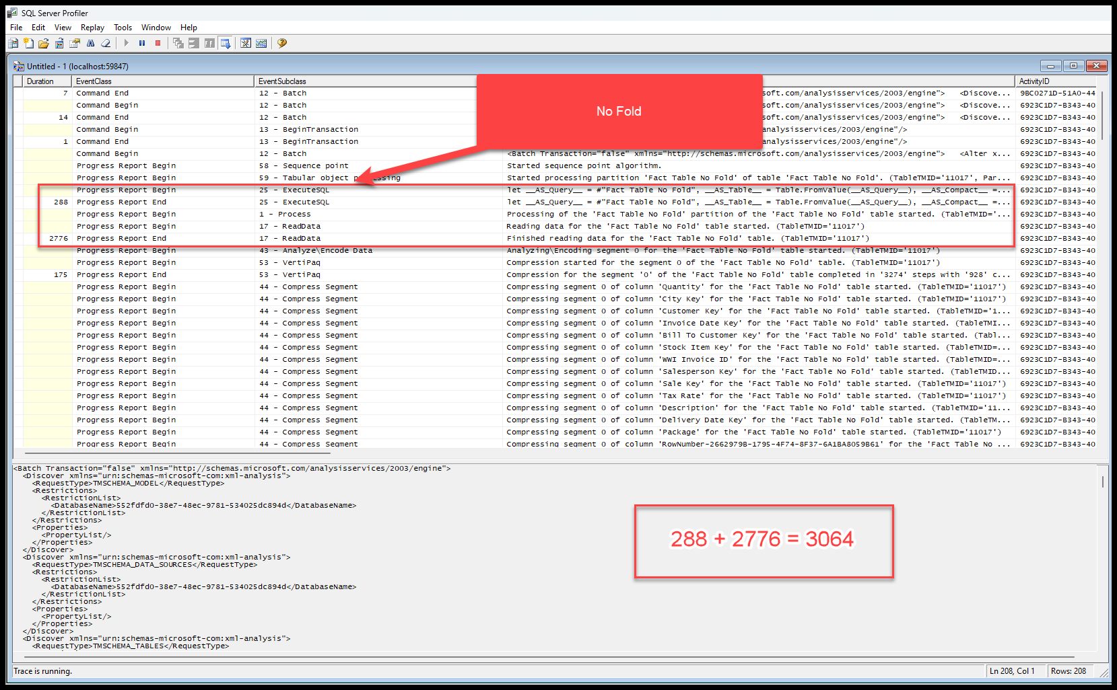

Slide 10
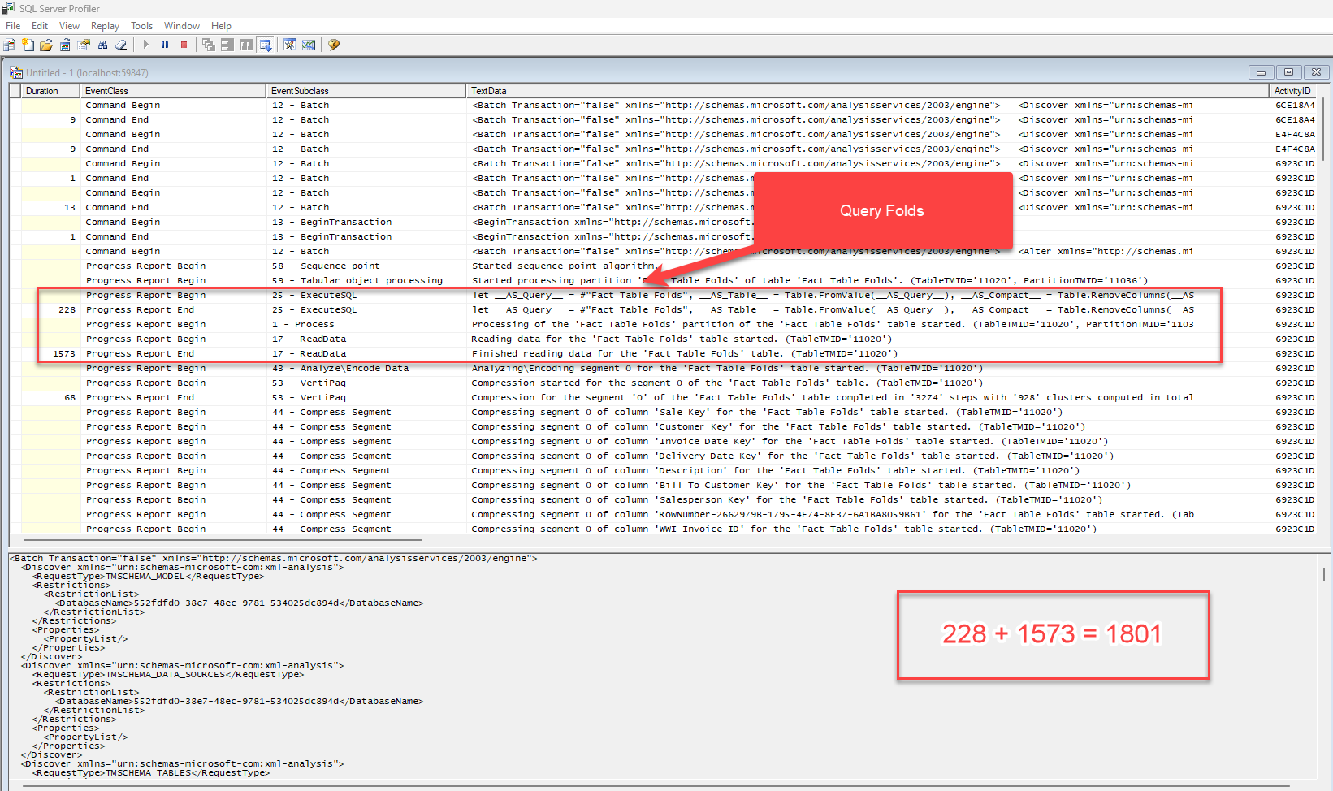

Slide 11
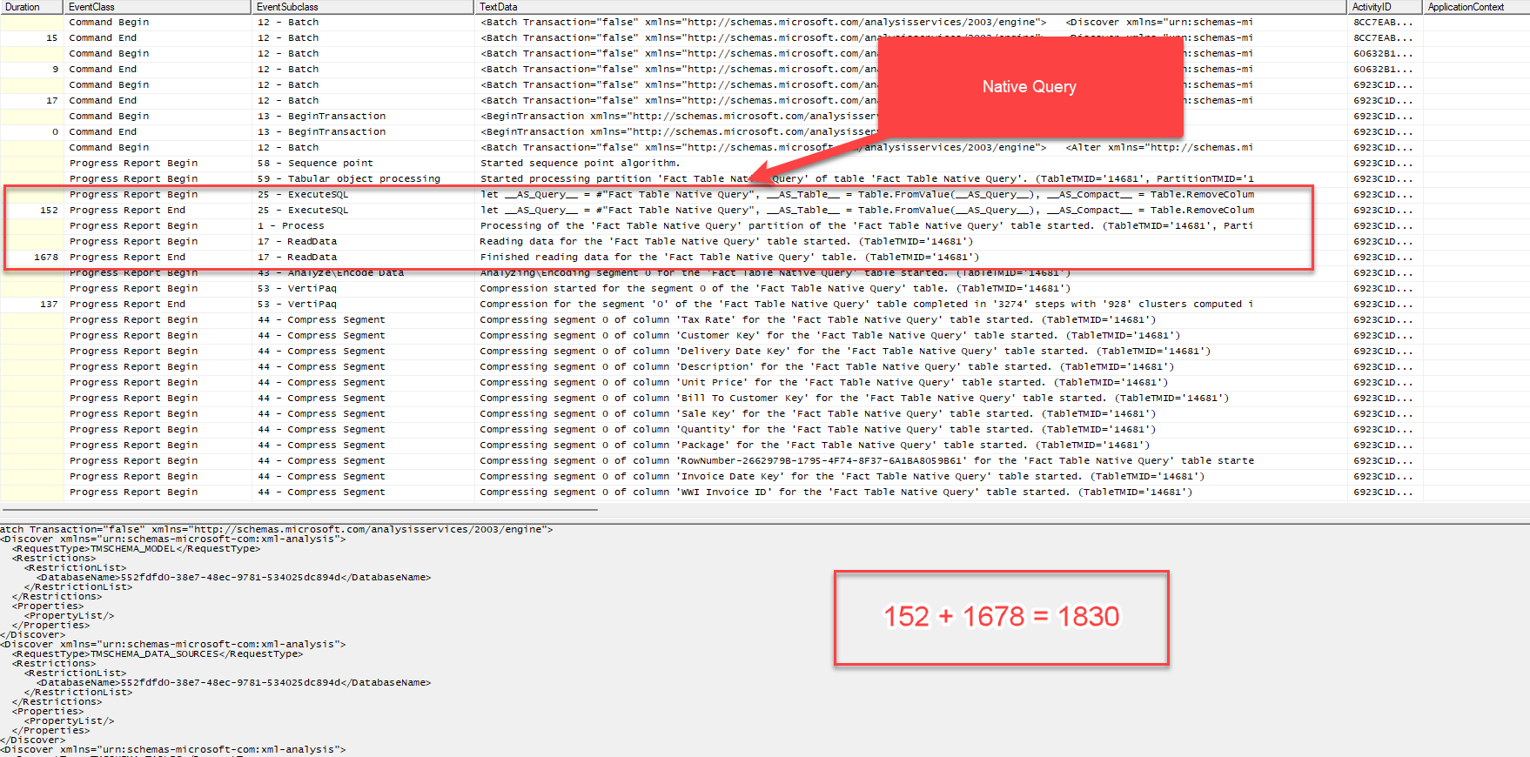

Slide 12
Transformations that Fold
Single SELECT using WHERE, GROUP BY AND JOIN with common column expressions:
Remove columns
Rename columns
Filter
Group by
Join and expand
Simple logic with M Functions that translate to SQL
PIVOT and UNPIVOT

Slide 13
Transformations that Don’t Fold (not exhaustive)
Single SELECT using WHERE, GROUP BY AND JOIN with common column expressions:
Merge based on different sources
Append queries based on different sources
Add an Index column
Complex logic – M functions that can’t be translated, eg,
Date.ToText([OrderDate], “yyyy”)
Privacy Levels

Slide 14
Considerations
Complex and not definitive
Push up stream but be aware of impact
Think about query process
Folding transformations first
Group transformations
Notes:
Basics: Spend the first 5 minutes explaining SQL and data querying.
Key terms: SQL, Database, Query.
Intro to Query Folding: 10 minutes
Definition: It's a technique that optimizes queries.
Benefits: Speeds up data retrieval.
Examples: 15 minutes
Demo 1: Query with query folding.
Demo 2: Query without query folding.
Show how to measure performance.
Do's and Don'ts: 10 minutes
Do's: Filters, column selection.
Don'ts: Custom columns, certain functions.
Tools and Monitoring: 5 minutes
Mention tools to monitor queries.
Q&A: 5-10 minutes
Take questions, clarify doubts.

Slide 15
Query Folding
How Queries are Excuted?
What is Query Folding?
Why is it important?
How do you know it’s happening?
What stops Query Folding?
Considerations
Notes:
Basics: Spend the first 5 minutes explaining SQL and data querying.
Key terms: SQL, Database, Query.
Intro to Query Folding: 10 minutes
Definition: It's a technique that optimizes queries.
Benefits: Speeds up data retrieval.
Examples: 15 minutes
Demo 1: Query with query folding.
Demo 2: Query without query folding.
Show how to measure performance.
Do's and Don'ts: 10 minutes
Do's: Filters, column selection.
Don'ts: Custom columns, certain functions.
Tools and Monitoring: 5 minutes
Mention tools to monitor queries.
Q&A: 5-10 minutes
Take questions, clarify doubts.

Slide 16
Resources
The (Almost) Definitive Guide to Query Folding - It's Not About The Cell (itsnotaboutthecell.com)
SQLBITS2022 - Chris Webb Performance Tuning and Dataflows in Power BI
Chris Webb blog
https://data-mozart.com/query-folding-devil-is-in-the-detail/
Sandeep Pawar Function to audit datasources for Query Folding
30 Day Query Folding Challenge
https://databayes.co.uk/power-bi-query-performance-tests/
Sql Server Profiler as External Tool

Slide 17
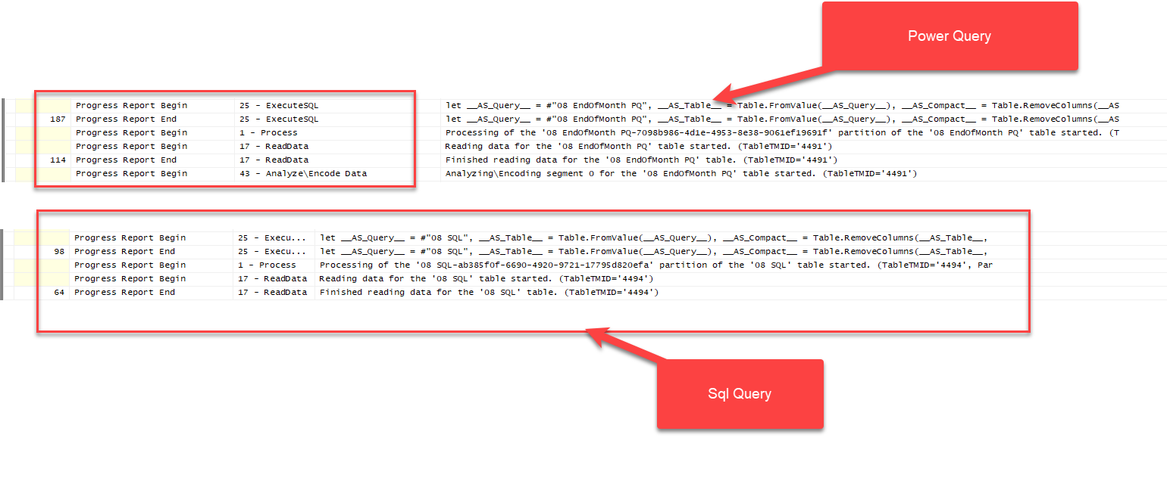
Power Query vs Sql Query

Slide 18
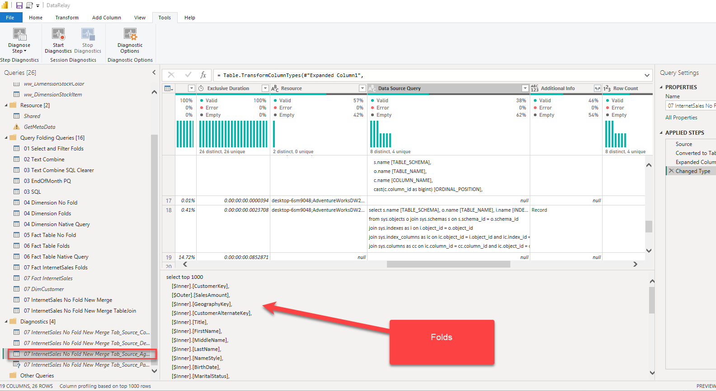
Query Diagnostics

Slide 19
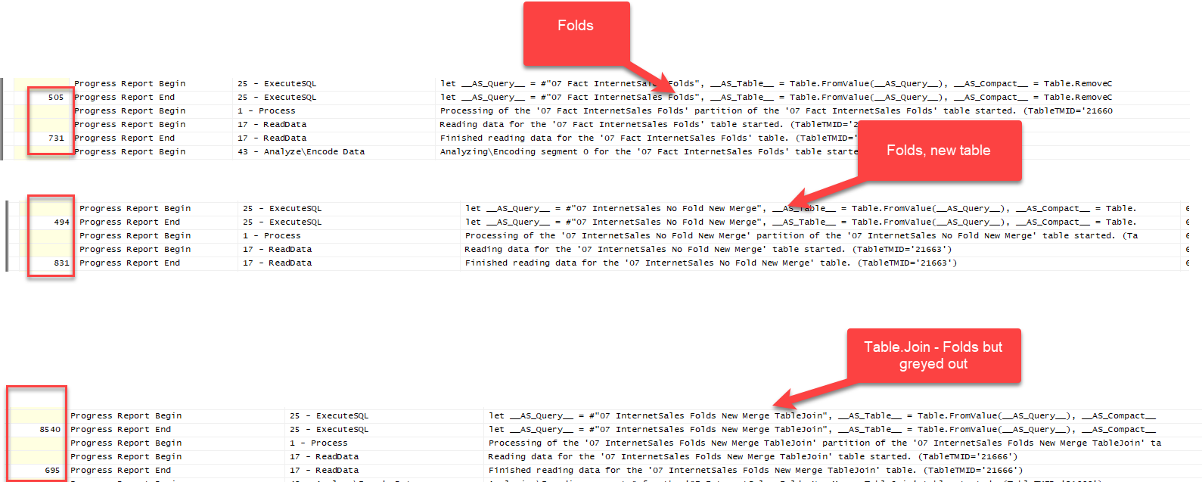
Joining Tables

